Slide 1
Alvarez - Our Family Tree
Alvarez Ancestors
Franco Ancestors
Where did we come from?
<number>
Notes:
<number>

Slide 2
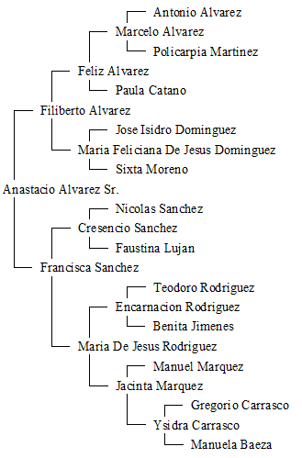
Alvarez Ancestors
<number>
Notes:
<number>

Slide 3
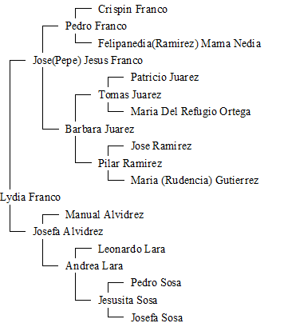
Franco Ancestors
<number>
Notes:
<number>

Slide 4
Where Did We Come From?
Alvarez – Loraine, Texas – 1930 Census
Franco – Colorado City – 1926 ?
Loraine population 2025 – 508
Colorado City population 2025 - 3980
<number>
Notes:
<number>

Slide 5
Where Did We Come From?
Alvarez – Ojinaga, Chihuahua, Mexico
Ojinaga was founded around AD 1200 by the Pueblo Native Americans. Ojinaga was first visited by Spanish explorers (led by Álvar Núñez Cabeza de Vaca) in 1535.
Franco – Coyame, Chihuahua, Mexico
Coyame was founded in 1715 by explorer Antonio Travina y Retes. Known for UFO sitings
<number>
Notes:
<number>

Slide 6
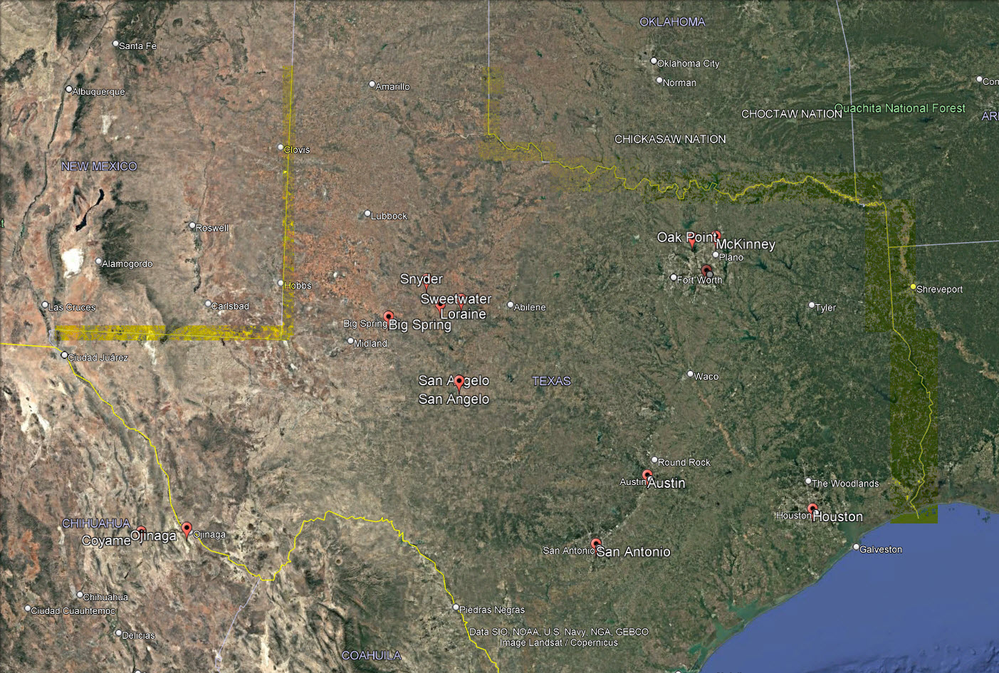
Coyame 55 miles from Ojinaga Ojinaga 375 miles from Loraine
<number>
Notes:
<number>

Slide 7
Alvarez
WIKI - Álvarez (sometimes Alvarez) is a Spanish patronymic surname meaning "son of Álvaro (or Álvar)"
Spanish/Portugese (Alvares) surname of Germanic origin
German tribes known as the Gotsh or Vizigoths from 5th century AD. Alvarez is the Latinized form of the Germanic personal name Adalwolf. Other spelling included Alvarado.
Juan Braba Albarez – 1st recorded spelling, March 15th 1548
Ojinaga was first visited by Spanish explorers (led by Álvar Núñez Cabeza de Vaca) in 1535
<number>
Notes:
<number>

Slide 8
Franco
WIKI - A Spanish, Portuguese and Italian surname, Franco comes from the term ‘frank’ which goes back to the 4th century Germanic tribe of invading Franks into what is present-day France
Franco is used as both a first and last name
Meaning – Frenchman or free one.
<number>
Notes:
<number>

Slide 9
DNA Test
2 types of DNA tests for Genealogy
mtDNA (Mitochondrial DNA)– Maternal relationship -
Y Chromosome – Paternal relationship
<number>
Notes:
<number>

Slide 10
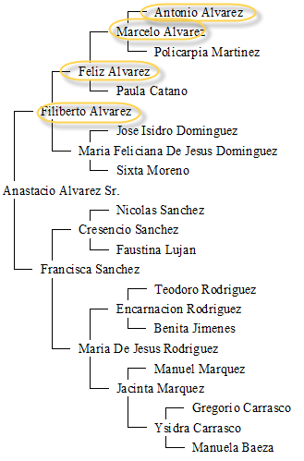
Y DNA
Follows only the male blood-line
<number>
Notes:
<number>

Slide 11
mtDNA
Follows only the female blood-line
<number>
Notes:
<number>

Slide 12
mtDNA Test Result – 2012 (Anastacio Alvarez) YDNA Test Result – 2015 (Andrew Alvarez)
Maternal Haplogroup : C1 (mtDNA - female)
Paternal Haplogroup : R1b1b2a1a (YDNA - male)
Haplogroup - Group of similar haplotypes that share a common ancestor
Haplotype – grouping of DNA pieces that tend to be inherited together
<number>
Notes:
<number>

Slide 13
Haplogroup R1b1b2a1a
Genetic Footprint
R1b1b2 – indicates European ancestry. Migrated ~ begin 17,000 years ago in Europe
R1b1b2 – 50% of men in western Europe. Example: Wales (92%), Basques(87%) (north-central Spain and south-western France), Irish (85%), Spain (81%) , French (80%), British (78%),Italy (76%)
<number>
Notes:
<number>

Slide 14
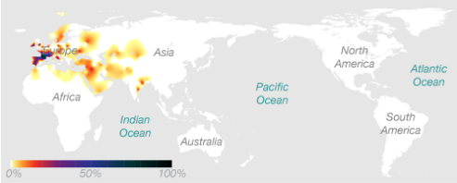
Haplogroup R1b1b2a1a
Many great people come from branches of this haplogroup
George Washington
Abraham Lincoln
Grover Cleveland
Charles Darwin
James K. Polk
Ulysses S. Grant
James Buchanan
<number>
Notes:
<number>

Slide 15
Haplogroup C1
C1 – indicates American Indian ancestry. Migrated ~ 20,000 years ago from northern Asia
C - believed to have arisen somewhere between the Caspian Sea and Lake Baikal some 60,000 years before present
<number>
Notes:
<number>

Slide 16
mtDNA
Follows only the female blood-line
<number>
Notes:
<number>

Slide 17
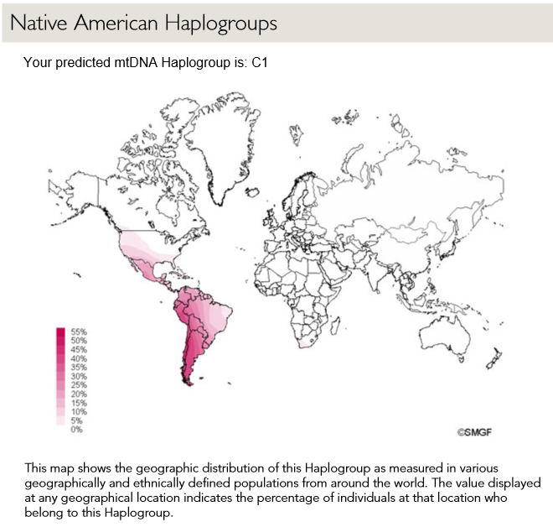
Haplogroup C1
<number>
Notes:
<number>

Slide 18
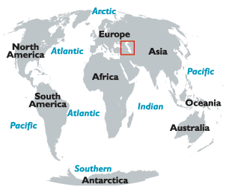
Caspian Sea
World's largest lake (by Russia and Iran)
<number>
Notes:
<number>

Slide 19
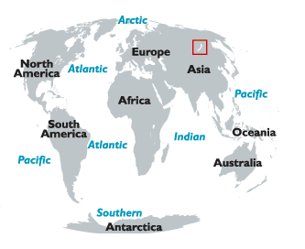
Lake Baikal
South of the Russian region of Siberia, north of Asia
Oldest and deepest freshwater lake in the planet.
<number>
Notes:
<number>

Slide 20
Haplogroup M, L
Haplogroup C is a child of group M. M is theorized to have originated in Asia.
M is a child of group L. M is thought to have been one of the main surviving lineages involved in the “out of Africa migration”
Africa is widely accepted as the geographic origin of modern humans
L -> M -> C -> C1
<number>
Notes:
<number>

Slide 21
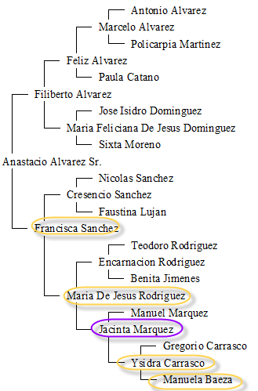
Jacinta Marquez was an adopted Indian
<number>
Notes:
<number>

Slide 22
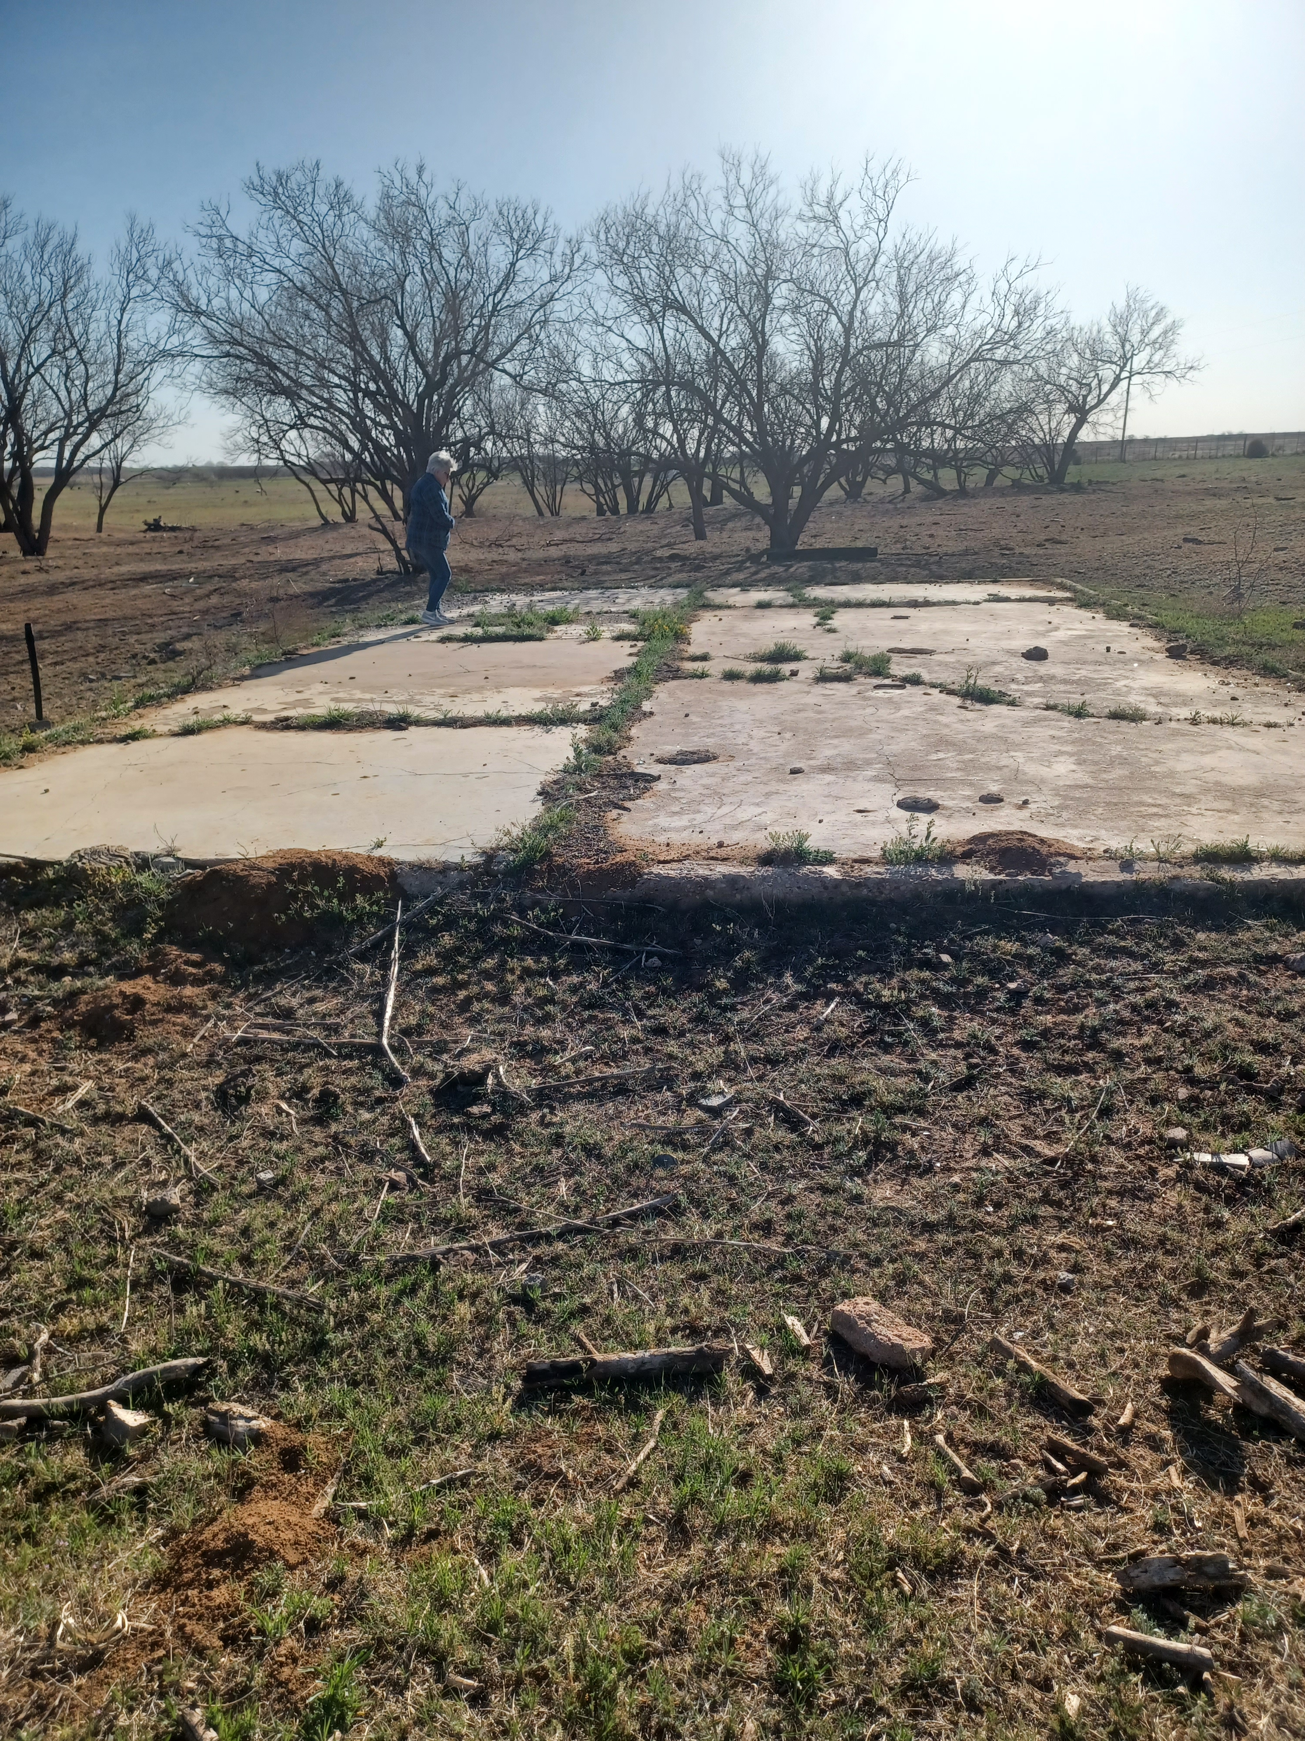
Bufford Home Slab

Slide 23
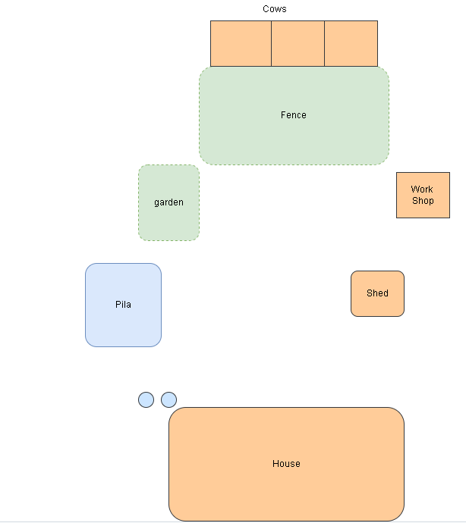
Bufford home layout

Slide 24
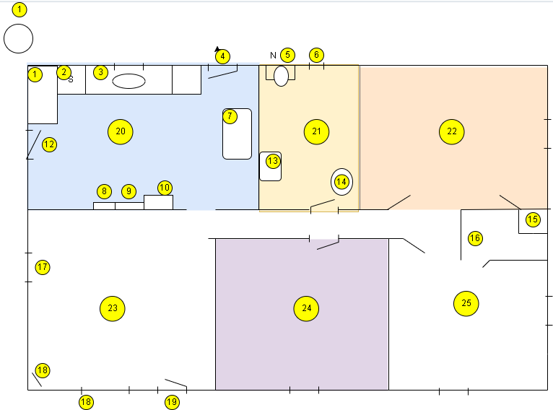
1 - kitchen cabinet
2 - stove
3 - kitchen cabinet
4 - back door
5 - commode
6 - bath window
7 - kitchen table
8 - pantry cabinet
9 - pantry cabinet
10 - fridge
11 - (n/a)
12 - kitchen side door
13 - batchroom sink
14 - water heater
15 - girls closet
16 - boys closet
17 - double window,
18 - TV
19 - front ddor facing south
20 - Kitchen
21 - bathroom
22 - girls bedroom (Anna, Lola, and the yourger kids)
23 - living room
24 - mom, dad bedroom with crib for little ones
25 - Daniel, Sammy, and Jr betroom

Slide 25
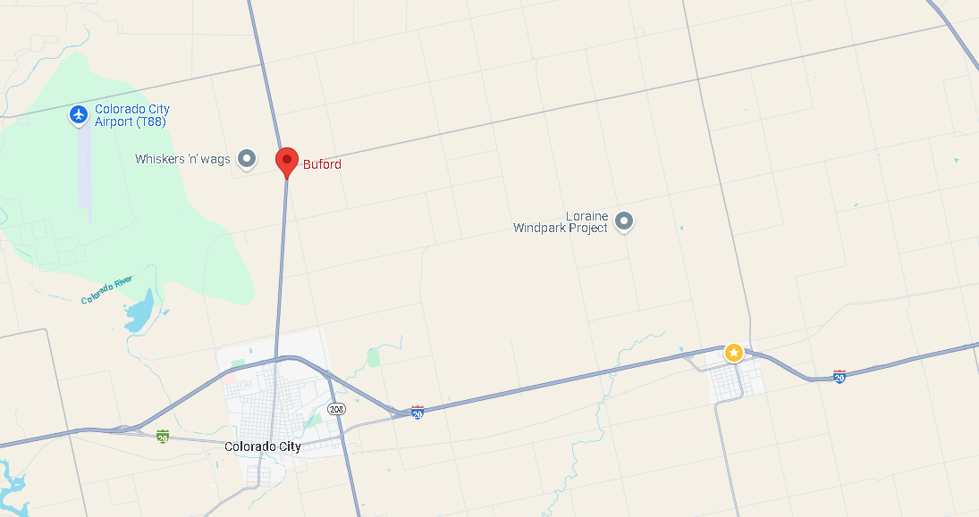
Bufford location

